Slide 1
Good and qualitative research requires
A plan of your work – 80/20 rule
Responsibilities and deadlines
Resources
Time management
Let’s define a plan of your future work

Slide 2
Deadlines
Topic’s submission
First report
Second report
Final draft
Final report
Defense

Slide 3

Creation of the “Skeleton” of your future work
Title
Abstract: A short description of the work
Table of content
Lists of figures, tables, algorithms, listings
Acronyms or/and Glossary
Introduction: Why you I choose this topic? Why it is important for present day?
Basic knowledge: What you need to know for understanding the work? What are the essentials of my work?

Slide 4
Creation of the “Skeleton” of your future work
State of the art. Literature review: What already was done in the scope of your topic? Why it doesn’t work properly/what you will improve?
Development. System design: How do you plan to solve the problem? Description of your solution.
Evaluation: How you plan to evaluate your approach? What are good criteria for assessing the quality of your approach? What metrics you will use?
Conclusions: Also may include perspectives for your work.
Bibliography

Slide 5
Why should I use LaTeX?
high typographical quality of the documents
well-organized computer science material
clear separation the content from the format of your document

Slide 6
You shouldn't use LaTeX:
You don't have time to learn it
Your document is already written
What you care about is the design of the document

Slide 7
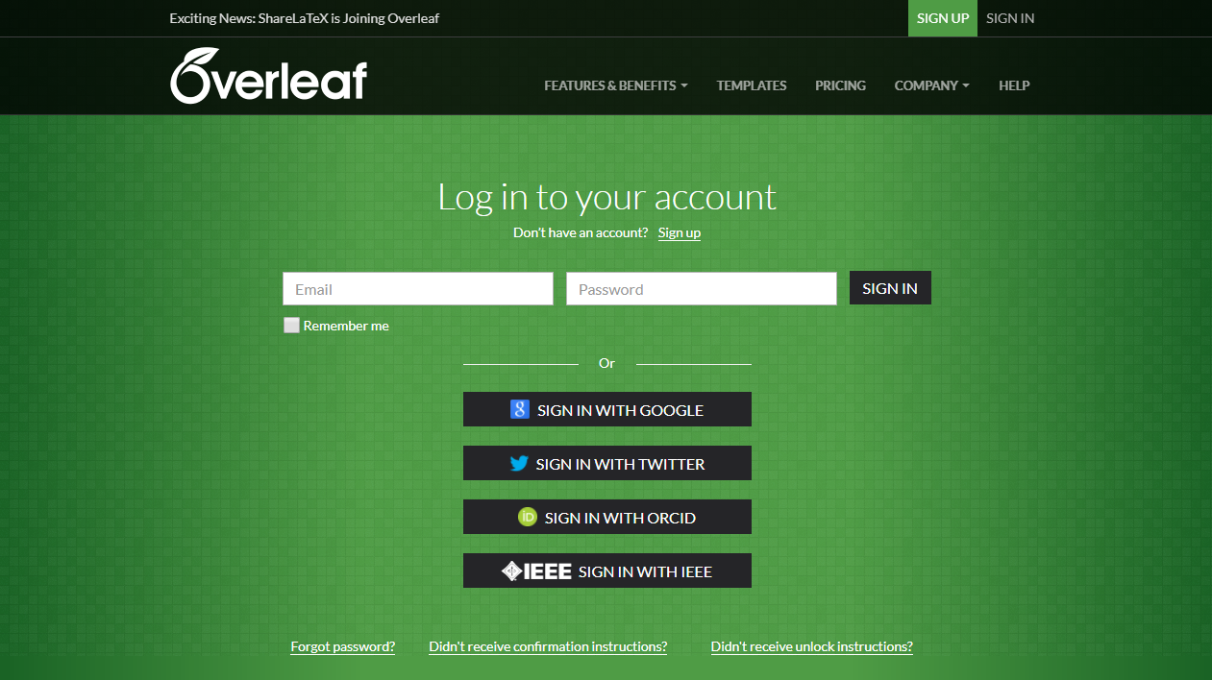
Overleaf platform

Slide 8
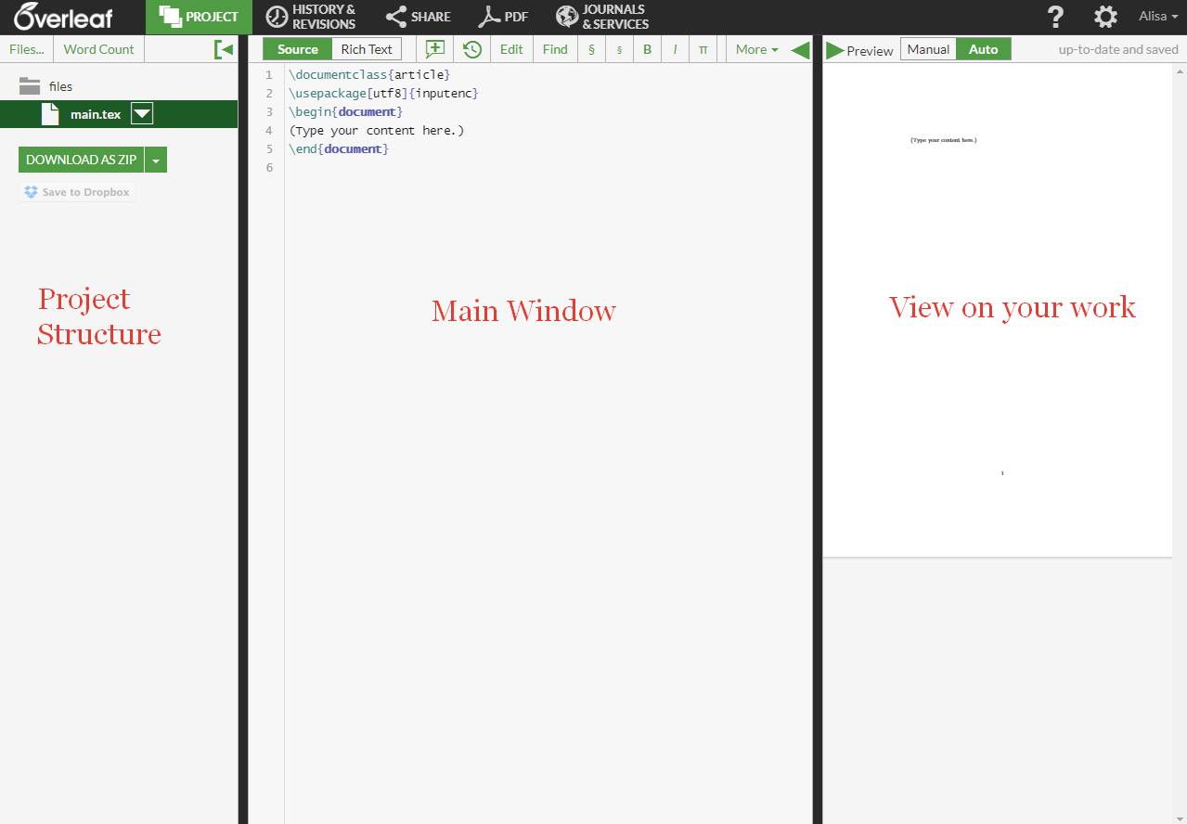
1. Create a new project in Overleaf environment New Project → Basics → Blank Paper

Slide 9
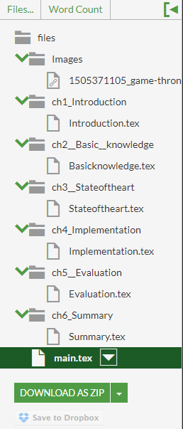
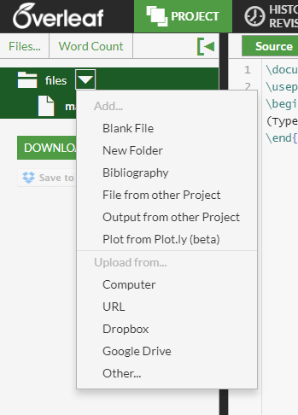
2. Create subfolders for different parts of your project. Files → New Folder/Blank File
Create folders with names:
ch1_Introduction,
ch2_ Basic_ knowledge,
ch3_ Stateoftheart,
ch4_Implementation,
ch5_ Evaluation,
ch6_Summary, Images.
In each “chapter” folder create
nameofthefolder.tex file.

Slide 10
Let’s make a cover for the research work
\documentclass{article}
\usepackage[utf8]{inputenc}
\usepackage{graphicx}
\graphicspath{ {Images/} }
\begin{document}
\include{cover}
\end{document}

Slide 11
Articles:
https://www.worldcat.org/
https://www.acm.org/
http://dblp.uni-trier.de/
Tables in Latex:
http://truben.no/table/
Math for Latex:
https://www.codecogs.com/latex/eqneditor.php
http://www.hostmath.com/

